Slide 1
Higher Education and Race
A Glance of Graduation Rates by Race in 4 Regions of the United States
By Mark A. Salazar

Slide 2
Topics
Tertiary education rates by State in 4 different regions of the United States
The different college graduation rates between 3 racial groups: Asian, Black, and White in 4 different regions of the US
Populations of the 3 racial groups and their relationship to graduation rates
Which racial group has the highest graduation rate, which group has the lowest
Reasons for the disparities
Recommendations to improve college graduation rates for lower performing groups
Actionable steps
Q&A

Slide 3
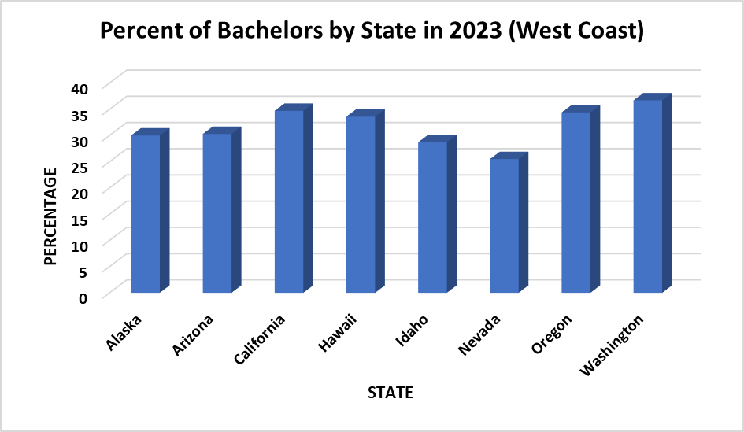
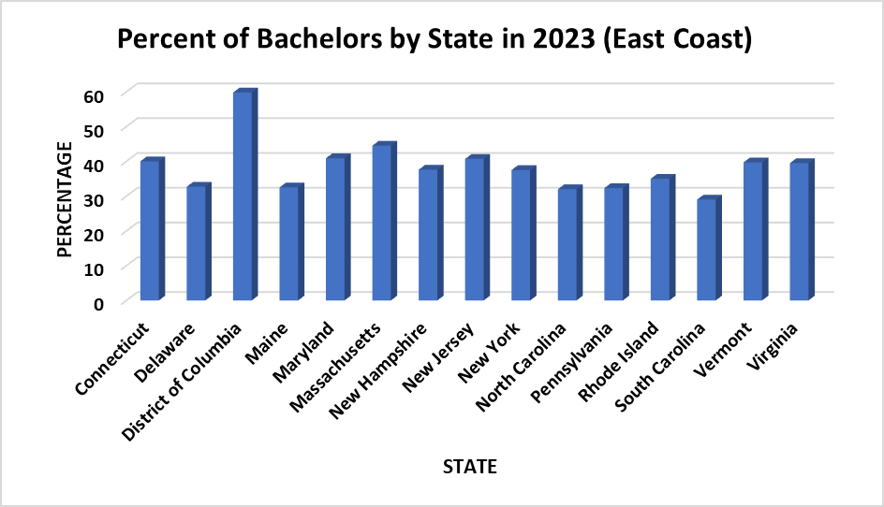
Graduation rates by State in 2023 (West & East Coasts)
East Coast generally has higher college graduation rates compared to the West Coast and the other 3 regions
The West Coast has a higher immigrant population demographic than the other regions, except the South
The East Coast has a more concentrated population center

Slide 4
Bachelors Degree by Race in 2023 (West & East Coasts)
By far, Asians have the highest rate of Bachelors degrees
Blacks have the lowest attainment rate of Bachelors degrees
Only in Alaska, Hawaii, and D.C. do Whites have a high college graduation rate than Asians

Slide 5
Population by State & Race in 2023 (West & East Coasts)
Blacks outnumber Asians in every state, yet have a much lower rate of Bachelors degrees
Whites outnumber both Blacks and Asians yet, have a lower Bachelors Degree attainment that Asians in most states (Alaska, Hawaii, and D.C)

Slide 6
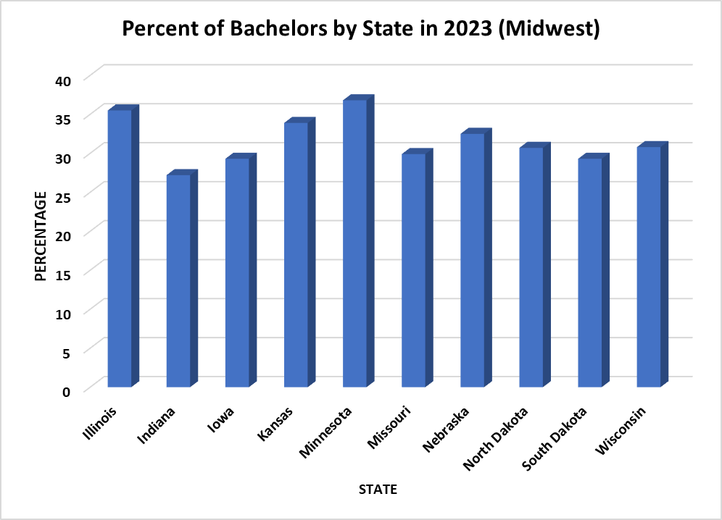
Graduation rates by State in 2023 (Midwest & South)
Across the board, the South has the lowest percentage of Bachelors Degree of the 4 regions
The Midwest is around the middle when it comes to percentage of Bachelors Degrees
Illinois and Minnesota lead the way for the Midwest
Georgia and Texas are the only southern states with college graduation rates above 30%

Slide 7
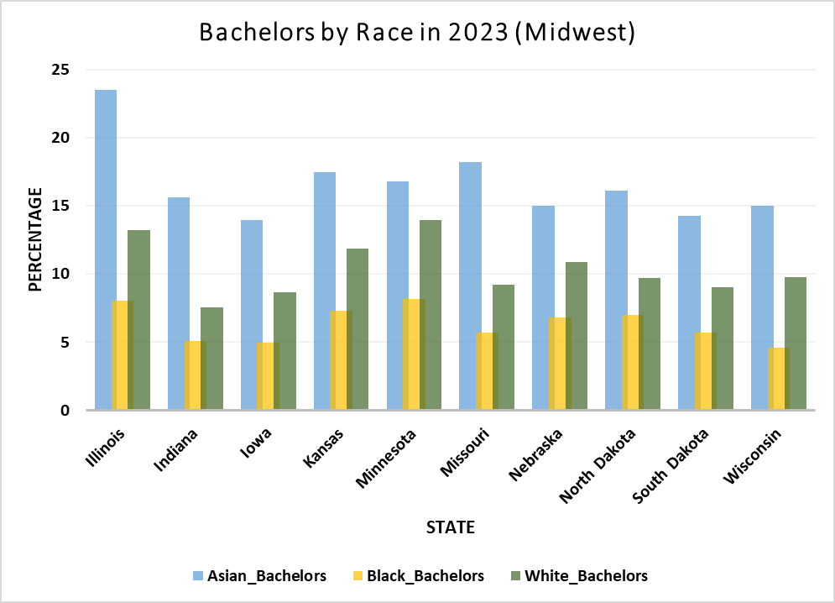
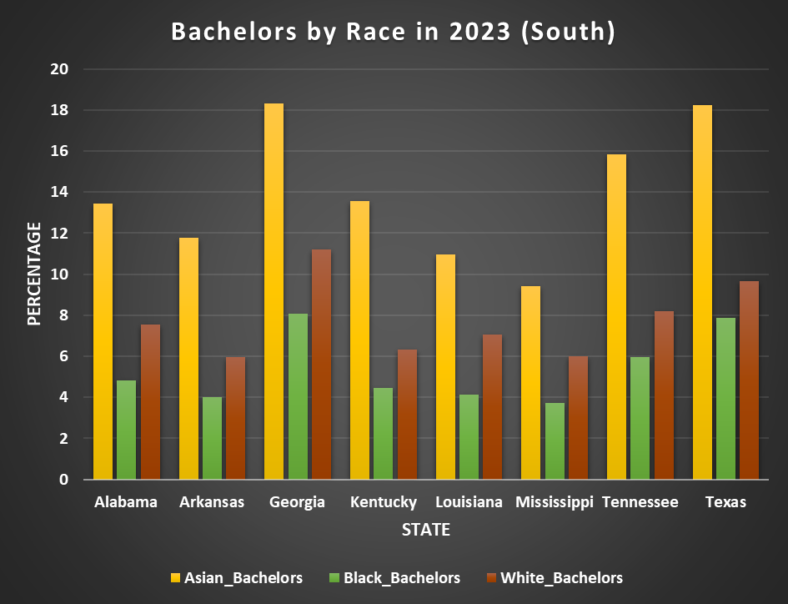
Bachelors Degree by Race in 2023 (Midwest & South)
In both the Midwest and the South, Blacks have the lowest Bachelors Degree attainment rates in the US
Asians have a higher college graduation rate across both regions
In states with larger populations (Texas) or with a large black population (Illinois and Georgia), Black people have higher rates of Bachelor attainment

Slide 8
Population by State & Race in 2023 (Midwest & South)
Despite their lower populations, relative to their size, Asians have a high rate of Bachelors degrees in the 4 different regions in US depicted in this slide show
African-Americans have the lowest rates of completed college education, except for states where an affluent Black community exists (Georgia, Maryland, D.C.)
Why the discrepancies?

Slide 9
Further Look Into the Discrepancies
The lowest college graduation rate (3.71%) for Blacks is in the South; the highest college grad rate (17.40%) for Blacks is on the East Coast
The lowest college grad rate (7.84%) for Asians is in Alaska; the highest (49.90%) is in D.C.
In the South, despite the Black population being over 7 times larger than the Asian population, Blacks have an average college grad rate about 2.5 times lower than Asians
On the West Coast is where the most equality is seen: Blacks have a population 2.5 times lower than Asians, but only have the college grad rate
On average, the East Coast is the most educated place (38.25%) by residents with Bachelors degrees; the South is the least educated (28.73%)

Slide 10
Recommendations
Invest into more scholarships for inner-city youth, a large chunk of the Black population resides
Invest into self-sustaining educational pipelines into higher education for the Black population in the South and Midwest
Research the reasons why Asian populations are well-represented in the college graduation rate compared to Blacks and Whites
Research why there’s a smaller discrepancy in college graduation rates by race in the West Coast

Slide 11
Actionable steps
Begin talks with non-profits to set up scholarships and educational services for inner-city youth, where the Black community has a large presence
Focus on regions with populations of Black residents with low college graduation rates (Midwest and South)
Talk with universities to gather data on Asian household metrics (parent’s education levels, income, national origin, etc.)

Slide 12
Questions
Ask away

